Slide 1


Artificial Intelligence (Machine Learning & Deep Learning)
NAVTCC & Strings Technologies
by Salman Ahmad

Slide 2
Outline Week 4 Day 3
Machine learning introduction and types
1
2
Classical machine learning pipeline
data collection, preprocessing, feature crafting,
3
4
modeling, testing and evaluation,
deployment
5

Slide 3
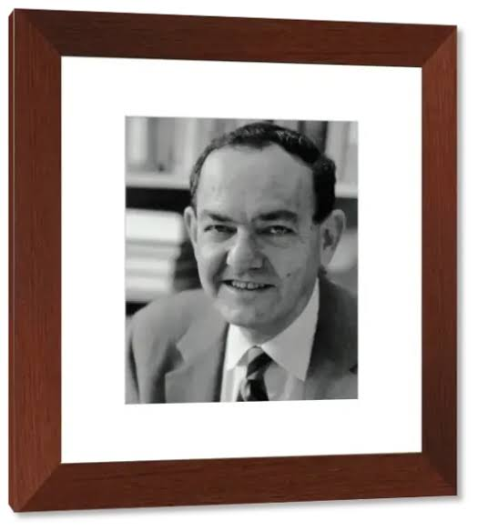
What is Machine Learning?
“Learning is any process by which a system improves performance from experience.”
Herbert Simon

Slide 4
What is Machine Learning?
A subset of AI that allows computers to learn from data and make decisions or predictions without being explicitly programmed.
ML systems improve automatically through experience.
Let the data speak — instead of hard-coding rules

Slide 5
What is Machine Learning?
Definition by Tom Mitchell (1998): Machine Learning is the study of algorithms that
improve their performance P
at some task T
with experience E.
A well-defined learning task is given by <P, T, E>

Slide 6
What is Machine Learning?
Traditional Programming
Data
Computer
Output
Program
Machine Learning
Data
Computer
Program
Output

Slide 7
When to use ML?
Human expertise does not exist (navigating on Mars)
Humans can’t explain their expertise (speech recognition)
Models must be customized (personalized medicine)
Models are based on huge amounts of data (genomics)

Slide 8
When Not to use ML?
You have very little data
The task can be solved with simple rules
You need 100% deterministic output

Slide 9
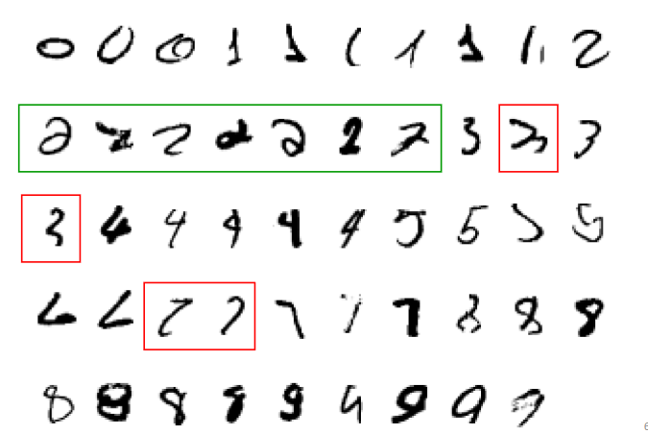
When to use ML?
A classic example of a task that requires machine learning:
It is very hard to say what makes a 2

Slide 10
Other Examples
Recognizing patterns:
Facial identities or facial expressions
Handwritten or spoken words
Medical images
Generating patterns:
Generating images or motion sequences
Recognizing anomalies:
Unusual credit card transactions
Unusual patterns of sensor readings in a nuclear power plant
Prediction:
Future stock prices or currency exchange rates

Slide 11
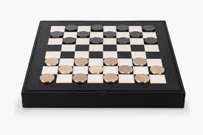
What is Machine Learning?
“Machine Learning: Field of study that gives
computers the ability to learn without being
explicitly programmed.” — Arthur Samuel (1959)

Slide 12
Defining the Learning Task
Improve on task T, with respect to performance metric P, based on experience E
T: Playing checkers
P: Percentage of games won against an arbitrary opponent
E: Playing practice games against itself
T: Recognizing hand-written words
P: Percentage of words correctly classified
E: Database of human-labeled images of handwritten words

Slide 13
Defining the Learning Task
Improve on task T, with respect to performance metric P, based on experience E
T: Driving on four-lane highways using vision sensors
P: Average distance traveled before a human-judged error
E: A sequence of images and steering commands recorded while
observing a human driver.
T: Categorize email messages as spam or legitimate.
P: Percentage of email messages correctly classified.
E: Database of emails, some with human-given labels

Slide 14
Types of Learning
Supervised (inductive) learning
Given: training data + desired outputs (labels)
Unsupervised learning
Given: training data (without desired outputs)
Semi-supervised learning
Given: training data + a few desired outputs
Reinforcement learning
Rewards from sequence of actions

Slide 15
Types of Learning
Supervised Learning
Learns from labeled data
Input → Output (e.g., image → “cat”)
Goal: Predict labels on new data
Examples:
Classification (e.g., spam vs. not spam)
Regression (e.g., predict house price)

Slide 16
Types of Learning
Unsupervised Learning
Learns from unlabeled data
Finds patterns or structure
Examples:
Clustering (e.g., customer segments)
Dimensionality reduction (e.g., PCA)

Slide 17
Types of Learning
Semi-Supervised Learning
Mix of labeled + unlabeled data
Helps when labels are costly but you have lots of raw data
A hybrid approach that combines a small amount of labeled data with a large amount of unlabeled data.
Learns patterns from both labeled and unlabeled examples.
Positioned between supervised and unsupervised learning.

Slide 18
Types of Learning
Reinforcement Learning
Learns via trial and error
Agent interacts with environment, gets rewards/penalties
Given a sequence of states and actions with (delayed) rewards, output a policy
Policy is a mapping from states à actions that tells you what to do in a given state
Examples:
Game-playing (e.g., AlphaGo)
Robotics and self-driving cars

Slide 19
Reinforcement Learning

Slide 20
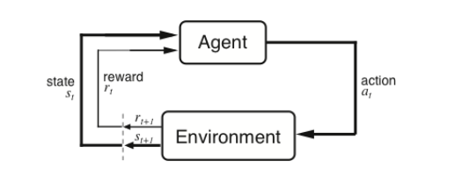
Reinforcement Learning
Agent observes state at step t : st ∈S
produces action at step t : at ∈ A(st )
gets resulting reward : rt +1 ∈ℜ
and resulting next state : st +1

Slide 21
Classical ML Pipeline
Data Collection
Pre-processing
Feature Crafting
Modeling
Testing
Deploy
A structured process that automates and streamlines the development of machine learning models

Slide 22
Data Collection
Pre-processing
Feature Crafting
Modeling
Testing
Deploy
Gather raw data from:
Databases, APIs, files (CSV, JSON)
Sensors, surveys, logs, scraping
Storing it in a data repository
Storing processed data
Storing raw data
Example: Collecting customer purchase history for churn prediction

Slide 23
Data Collection
Pre-processing
Feature Crafting
Modeling
Testing
Deploy
Clean and structure raw data:
Handle missing values
Normalize/standardize numeric features
Encode categorical variables (label/one-hot encoding)
Remove duplicates & outliers
ETL and ELT
Goal: Make data usable for ML models

Slide 24
Data Collection
Pre-processing
Feature Crafting
Modeling
Testing
Deploy
A feature (also known as a variable or attribute) is an individual measurable property or characteristic of a data point that is used as input for a machine learning algorithm
Extract, select, or create meaningful inputs:
Combine or transform columns
Text → word counts, TF-IDF
Date → day/month/weekend
Polynomial features, interaction terms
Key to improving model performance

Slide 25
Data Collection
Pre-processing
Feature Crafting
Modeling
Testing
Deploy
Choose algorithm (e.g., Decision Tree, SVM, Random Forest, etc.)
Split data into:
Train
validation
test sets
Train model to learn patterns from data
Tune hyperparameters (e.g., learning rate, max_depth)

Slide 26
Data Collection
Pre-processing
Feature Crafting
Modeling
Testing
Deploy
Test model on unseen data
Use metrics:
Classification: Accuracy, Precision, Recall, F1-score, AUC
Regression: MSE, MAE, R²
Cross-validation to check generalization
Avoid overfitting/underfitting
Overfitting — model learns the training data too well, including noise and irrelevant details, leads to poor performance on test set
Underfitting — model is too simple to capture the underlying patterns in the data, poor performance on test and train set

Slide 27
Data Collection
Pre-processing
Feature Crafting
Modeling
Testing
Deploy
Integrate the trained model into real-world applications:
Expose via API
Embed in web/mobile apps
Monitor performance in production
Optionally retrain with new data (MLOps)

Slide 28

Questions?
"He who asks a question is a fool for a minute; he who does not remains a fool forever." – Confucius

